Slide 1
Matrix Operations in C
By: Mher Baburyan

Slide 2
Addition Matrices
Subtract Matrices
Multiply Matrices
Transpose Matrix
Scalar Multiply Matrix
Determinant of NxN Matrix
LU Factorization
Row Echelon Form
Operations

Slide 3
Table of contents
01
02
03
Theoretical
Code Snippets
We will learn the theory needed for using
Short about the code
Code Running
Will run the code and show how to use it

Slide 4
Theory

Slide 5

Theoretical Part
Matrices are 2D arrays that are very prevalent in Engineering and other Science related fields.
In Engineering, matrices are used everywhere : starting from Linear Algebra and ending with Computer Aided Design.

Slide 6
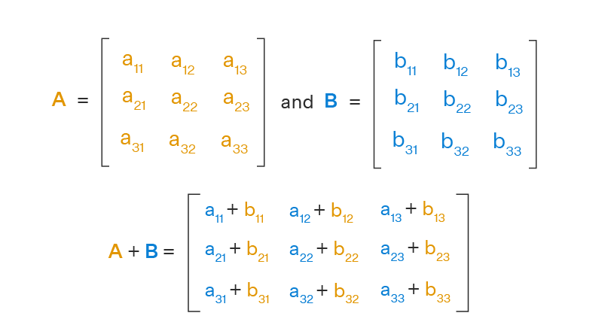
Linear Algebra : Matrix Addition
Must have same dimensions

Slide 7
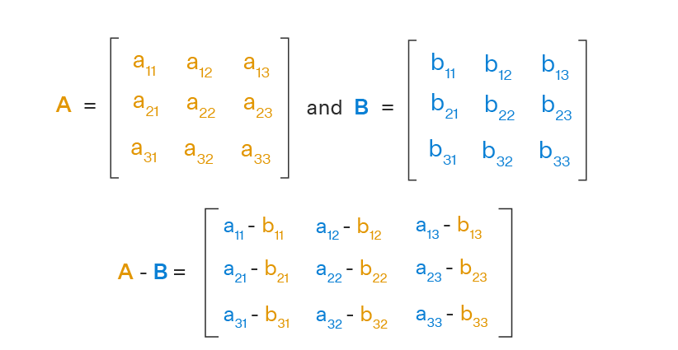
Linear Algebra : Matrix Subtraction
Must have same dimensions

Slide 8
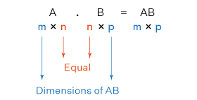
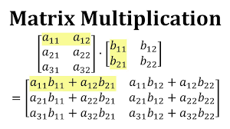
Linear Algebra : Matrix Multiplication
The number of Columns of A must equal the number of Rows of matrix B

Slide 9
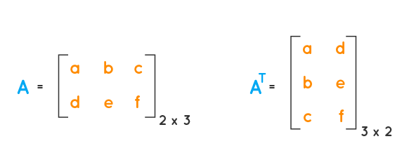
Linear Algebra : Transpose Matrix

Slide 10
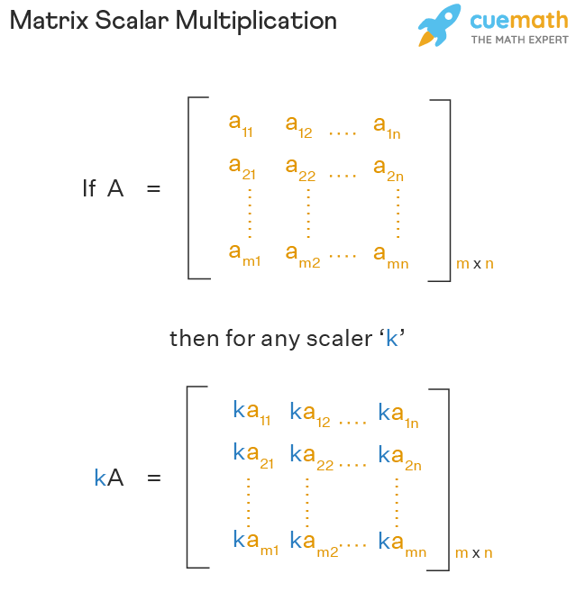
Linear Algebra : Scalar Multiplication Matrix

Slide 11
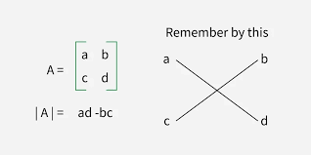
Linear Algebra : Determinant of Matrix
Must be a square matrix
(Columns and Rows are equal)

Slide 12
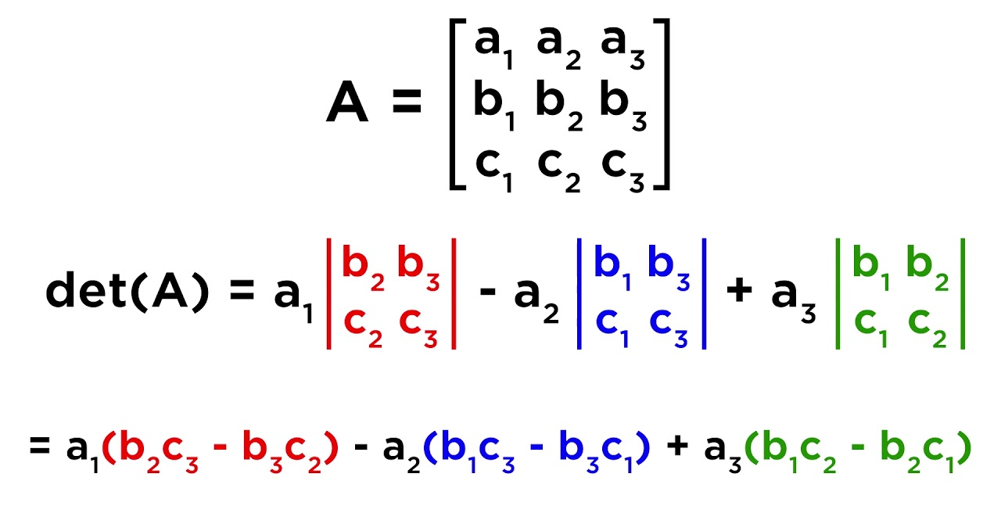
Linear Algebra : Determinant of Matrix
Laplace Expansion

Slide 13
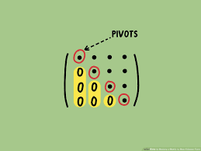
Linear Algebra : Row Echelon Form
Pivot is the first non-zero entry in a row
Must be a square matrix
(Columns and Rows are equal)

Slide 14
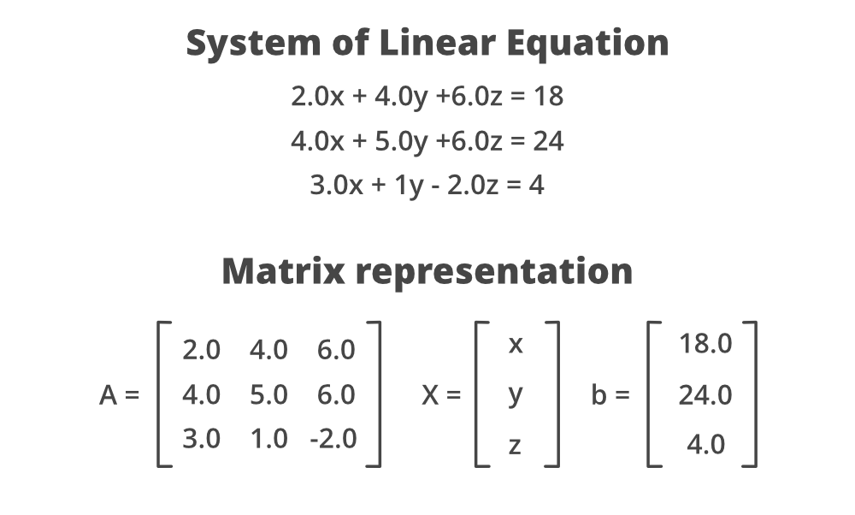
Linear Algebra : LU Factorization
Must be a square matrix
(Columns and Rows are equal)
Must be a Non-Singular matrix
(Must have an Inverse and non 0 determinant)

Slide 15
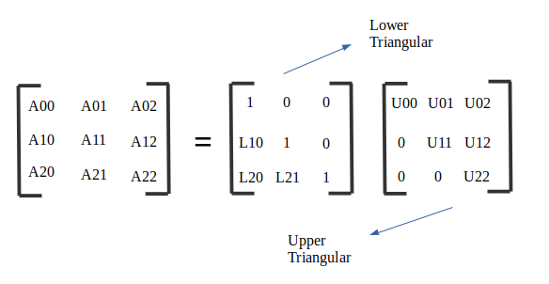
Linear Algebra : LU Factorization
Must be a square matrix
(Columns and Rows are equal)
Must be a Non-Singular matrix
(Must have an Inverse and non 0 determinant)

Slide 16
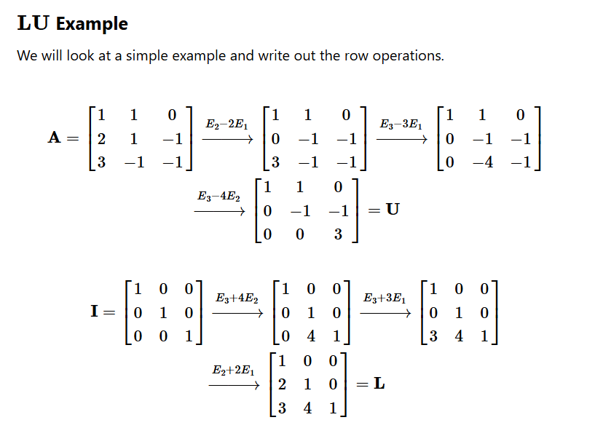
Linear Algebra : LU Factorization

Slide 17
Code Snippets

Slide 18
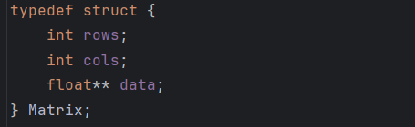
Code Snippets
The Matrix struct defines a dynamic matrix by storing its number of rows, number of columns, and a pointer to a 2D array of floating-point elements in it.
The two pointers allow us to create a dynamic array of rows, where each row is itself a dynamic array of floating-point numbers.

Slide 19
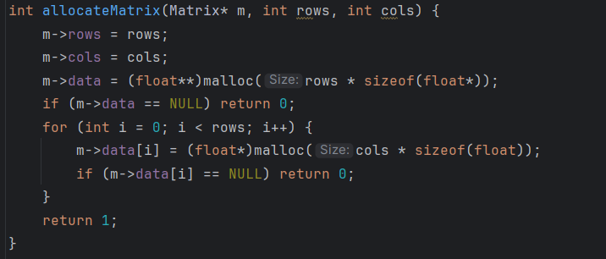
Code Snippets
The “allocateMatrix” function creates space in memory for a matrix of floating-point numbers. It takes the number of rows and columns and saves them in the matrix structure. Then, it allocates memory for each row and for the elements in each row.

Slide 20
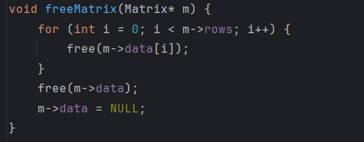
Code Snippets
Here we free the memory we allocated earlier. We free memory to avoid leaks.

Slide 21
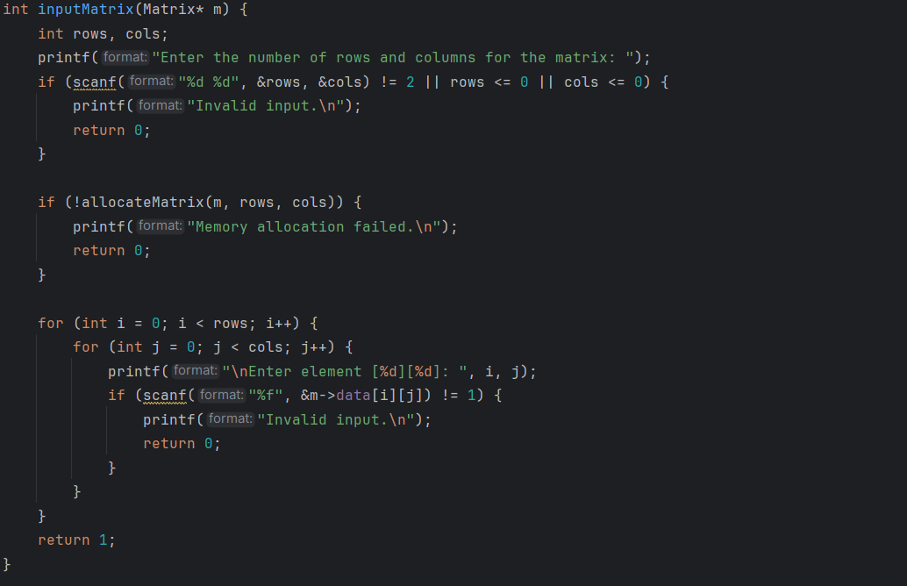
Code Snippets
This takes a pointer to a Matrix structure as input. It prompts the user to enter the number of rows and columns for the matrix, reads these values, and validates the input to ensure exactly two positive integers are provided.
After the user enters the number of rows and columns, the code proceeds asking for the elements of the matrix.

Slide 22
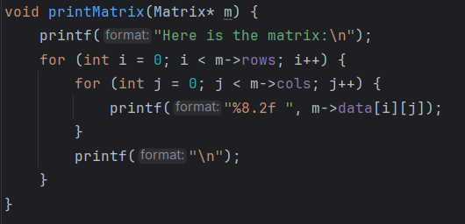
Code Snippets
Prints each matrix element formatted to two decimal places.

Slide 23
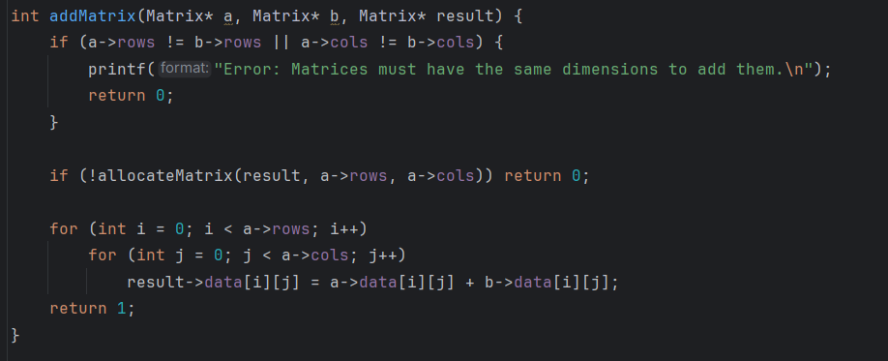
Code Snippets
If the rows of the “a” matrix is not equal to the rows of the “b” matrix, or their columns aren’t equal to each other, the addition would fail.
It also checks if there was memory allocated, if not it returns 0.
The for loop adds matrices of the same size to each other and stores it in a matrix.

Slide 24
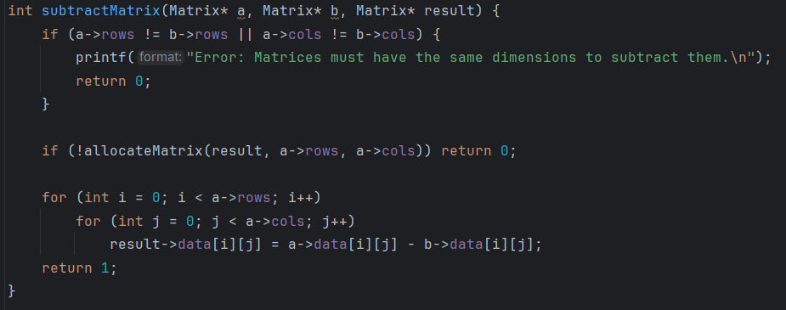
Code Snippets
If the rows of the “a” matrix is not equal to the rows of the “b” matrix, or their columns aren’t equal to each other, the subtraction would fail.
It also checks if there was memory allocated, if no it returns 0.
The for loop subtracts matrices of equal dimensions and stores result in another matrix.

Slide 25
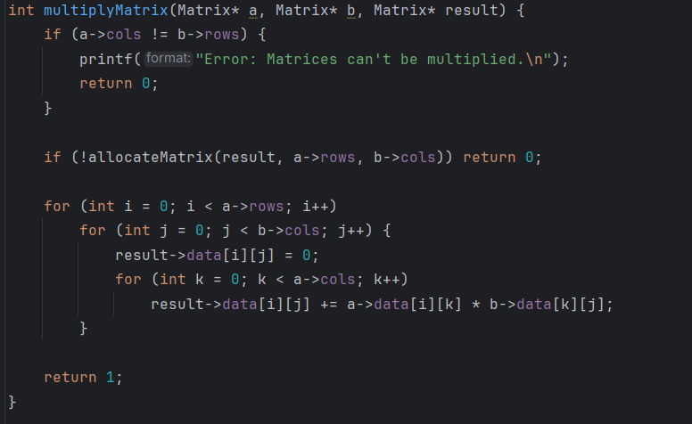
Code Snippets
If the columns of matrix “a” is not equal to the rows of matrix “b”, the multiplication would fail.
It also checks if there was memory allocated, if no it returns 0.
The for loop performs matrix multiplication by computing each element of the result matrix as the dot product of a row from matrix “a” and a column from matrix “b”. It goes through each row of “a” and each column of “b”, initializing the result cell to zero, then accumulates the sum of products.

Slide 26
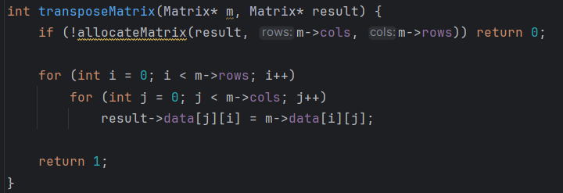
Code Snippets
First line checks if there was memory allocated, if no it returns 0.
The for loop swap rows and columns of the original matrix. The resulting matrix will have the columns as the rows of the original matrix, and the rows as the columns of the original matrix (due to them being swapped for the matrix to be transposed).

Slide 27
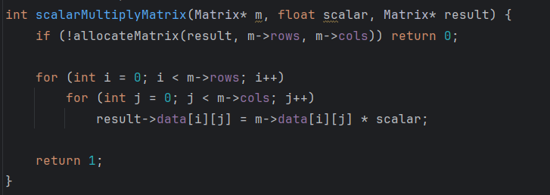
Code Snippets
First line checks if there was memory allocated, if no it returns 0.
The for loop multiplies every matrix element by a scalar value.

Slide 28
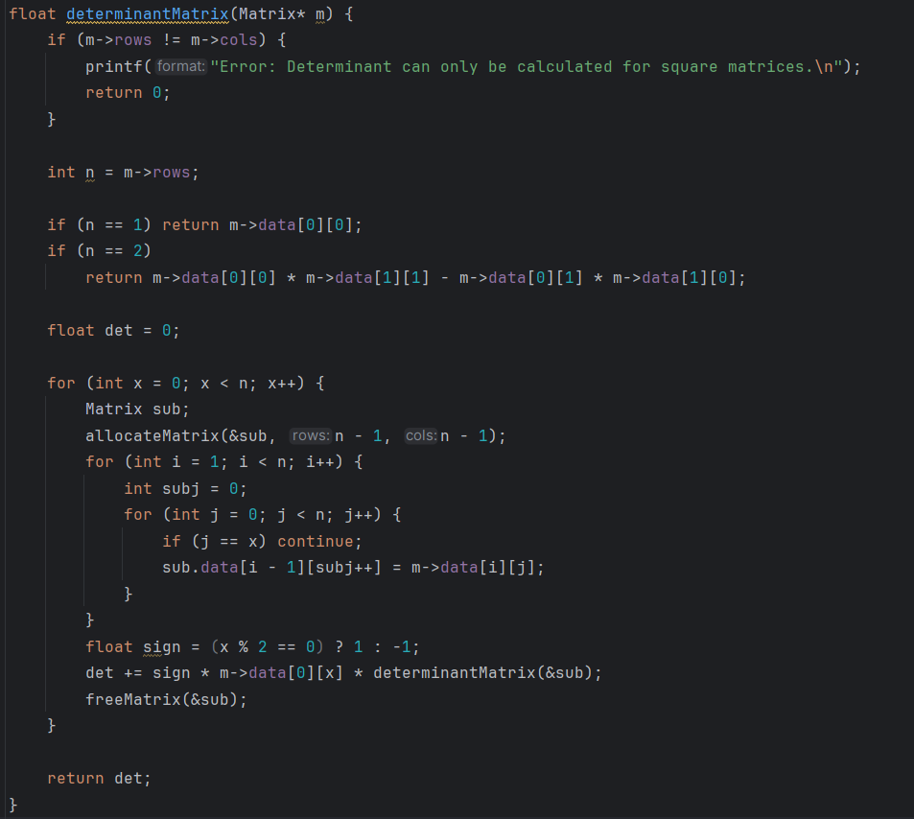
Code Snippets
If rows and columns are not equal, meaning it is not a square matrix, the calculation of the determinant would fail.
If the number of rows is 1, meaning there is only one element in the matrix, the determinant would be that element. If the matrix is 2x2, the determinant is computed normally.
If more, it is calculated with the help of the Laplace Expansion.

Slide 29
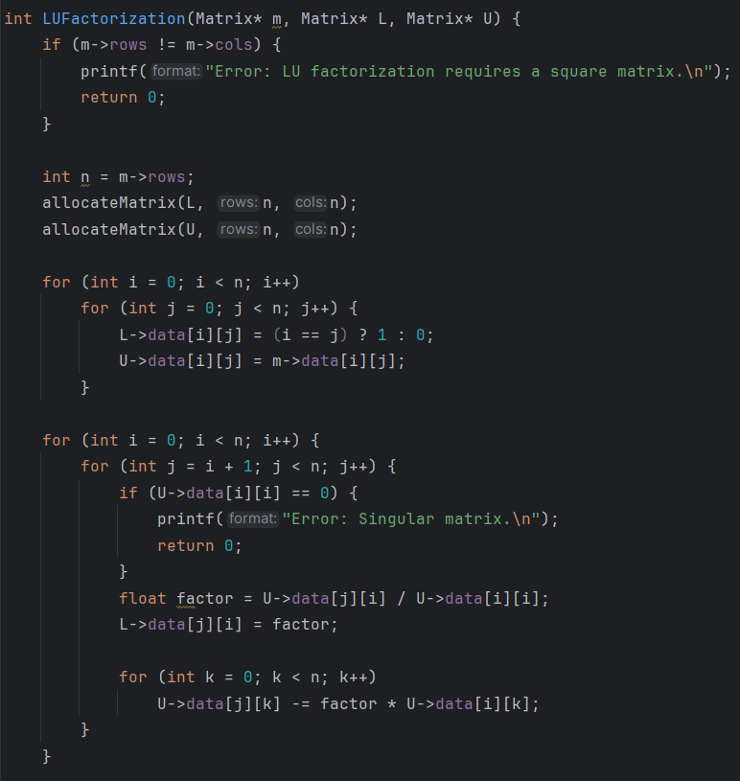
Code Snippets
If rows and columns are equal, meaning it is not a square matrix, the calculation of the determinant would fail.
We allocate memory for the L (Lower triangular) and U (Upper triangular) Matrices. Here we make the “U” matrix equal to our original. And If the element is in the diagonal of the L matrix, it must be 1.
We check if the matrix is singular or not
This part iteratively eliminates elements below the pivot in the U matrix and stores the corresponding multipliers in the L matrix. If a pivot element is zero, the matrix is singular and the process stops with an error message.

Slide 30
Code Snippets
If rows and columns are equal, meaning it is not a square matrix, the calculation of the determinant would fail.
We allocate memory for the L (Lower triangular) and U (Upper triangular) Matrices. Here we make the “U” matrix equal to our original. And If the element is in the diagonal of the L matrix, it must be 1.
We check if the matrix is singular or not
This part iteratively eliminates elements below the pivot in the U matrix and stores the corresponding multipliers in the L matrix. If a pivot element is zero, the matrix is singular and the process stops with an error message.

Slide 31
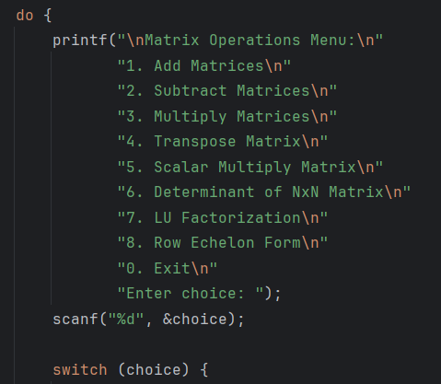
Code Snippets
This part of the code constantly asks the user to for an input until “0” is entered.
Depending on the input, it will call the corresponding function

Slide 32
Code Running

